Slide 1
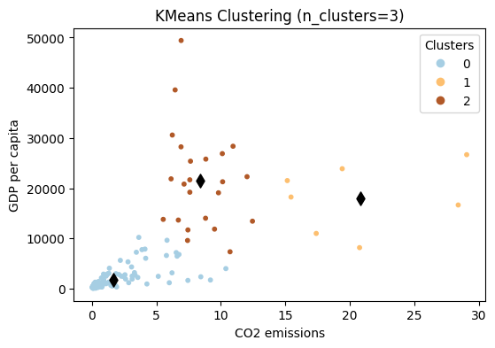
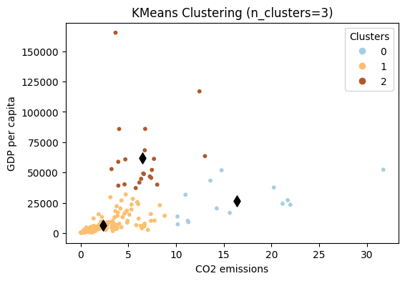
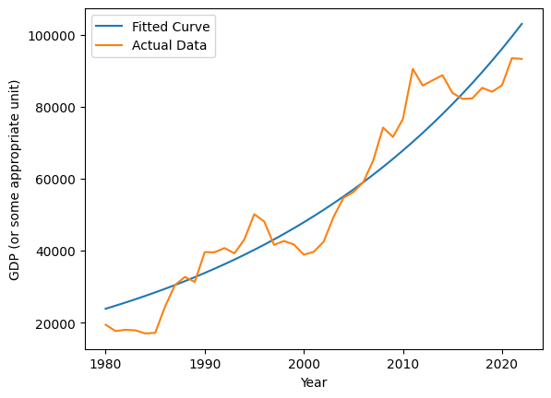
Co2 emission effect on GDP per capita By Mansoor Kashif
Github Repo link : https://github.com/mansoorkashif1997/ADS-assignment-3.git
Abstract & Introduction
The major factor that is contributing towards the climate change is Co2 emissions. The rise in industrial, commercial and economic activities has caused changes in weather and temperature of World. These climate changes are the causing change in rainfall pattern, increasing temperature, and other natural disasters. This study aims a look at the major cause of these change i,e Co2 emission and how it effects GDP.
1990 | 2020
Figure show that cluster analysis of countries all over the world based on Co2 emission and GDP per capita. The analysis was carried out for year 1990 and 2020 to observe cluster overtime. The goal is shed light on how economic factor and Co2 emission are related. Most countries have seen reduced Co2 emission as the cluster can be seen move towards left. However, GDP per capita have increased.
Switzerland is selected to show GDP per capita projection. There is a projected exponential growth in GDP per capita which shows that Switzerland will continue to be one of richest country .
Conclusion
This study helps to understand that Co2 emission reduced possibly due to increase in population and GDP per capita is on the rise,, it can also be concluded the further environment problems may arises due to urbanization. Necessary steps should be taken to ensure that climate does not bear the cost of advancement.

